Slide 1
EduTranscriptMiner: LDA Based Information Retrieval System for Educational Transcripts
Turcu Gabriel
FACULTY OF AUTOMATION, COMPUTERS AND ELECTRONICS Craiova
University of Craiova
Coordinators:
Assoc. Prof. Cristian Mihăescu, PhD.
Dr. Javier Palanca from Polytechnic University of Valencia

Slide 2
Introduction
During the last few years, Massive Online Open Courses (MOOCs) and Technology Enhanced Learning (TEL) platforms have seen a growth in popularity.
Because of this increase in popularity, the importance of having an efficient and precise retrieval system for educational videos has been highlighted
The increase in popularity of these platforms has also brought an increase in the amount of content. The problem with most of this content is that it’s incorrectly marked:
Misleading title
Missing keywords
Missing labels
Not categorized in any way.
Because of this, there is a need for a retrieval system based on the content from these videos that doesn’t require manual preprocessing (manually adding keywords, labels, etc.)

Slide 3
Task Description
The website containing the educational resources of a video format from the Polytechnic University of Valencia has this issue and requires a custom content based retrieval system for the videos they have uploaded on their website.
They have 45.128 videos, out of which, 16.012 videos have transcripts available.
The website includes videos from multiple domains so we will need to separate videos according to their domain.
Given a search query, we want to recommend a list of videos whose content resembles our query the most.

Slide 4
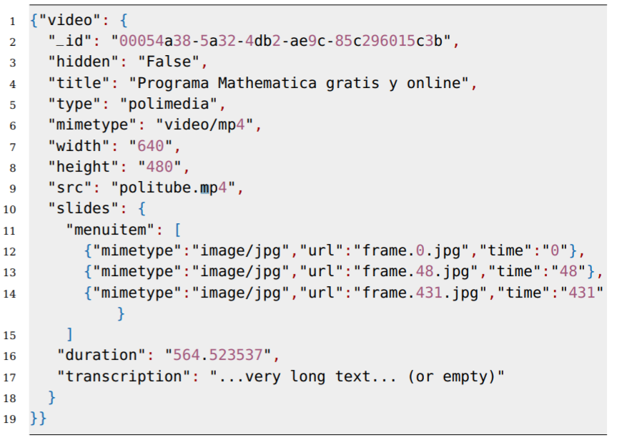
Task Description: Input
All the meta-data from the videos is available in a .json file that has the following structure:
From this file, we will extract and use the transcripts.

Slide 5
Task Description: Output
The output for a search query will be a list containing video IDs whose content from the transcript resembles the most the search query.
The output will be presented in the following format:
Video ID, Difference(The smaller the difference, the bigger the resemblance)
Example:
Query: “Ciencias de la Computacion”
Output:
(41107, 0.1097)
(765, 0.1120)
(18460, 0.1124)
(3895, 0.1141)
(1236, 0.1146)

Slide 6
Proposed Solution
Build Bag of Words from the transcripts using tokenization.
Compute NNLM(Neural Network Language Models) Word embedding results.
Cluster the transcripts into 3 clusters(domains) using the NNLM results.
Create 3 LDA models using the BoW, one for each domain.
Get a query, compare the LDA results of the query with the LDA results of all the transcripts in the same cluster as our query and get a ranked list.

Slide 7
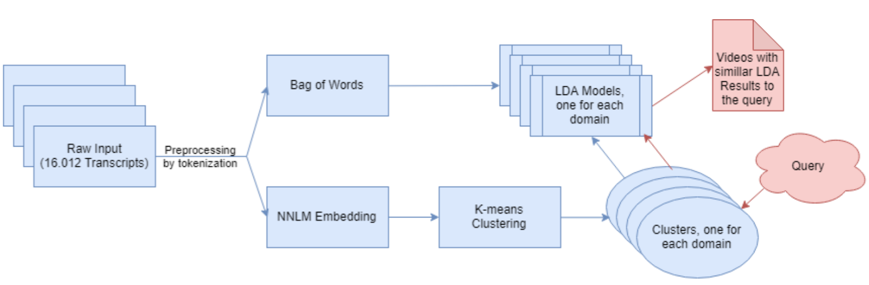
Outline of the Data Analysis Pipeline

Slide 8
Tools and Technologies
Python algorithms and libraries used in the making of this project:
KMeans clustering algorithm from sklearn.
LDA (Latent Dirichlet Allocation ) algorithm from gensim.
NNLM word embeddings algorithm from TensorFlow.
PyQt5 for creating the GUI.

Slide 9
Approach Neural Network Language Models
A neural network language model is a language model based on Neural Networks , exploiting their ability to learn distributed representations to reduce the impact of the curse of dimensionality.
The basic idea is to learn to associate each word in the dictionary with a continuous-valued vector representation. Each word corresponds to a point in a feature space.
The hope is that functionally similar words get to be closer to each other in that space, at least along some directions
We will use NNLM word embedding to transform transcripts into a data format our clustering algorithm understands.

Slide 10
Approach K-Means
Steps of the K-Means algorithm:
k initial "means" (in this case k=3) are randomly generated within the data domain (shown in color).
k clusters are created by associating every observation with the nearest mean.
The centroid of each of the k clusters becomes the new mean.
Steps 2 and 3 are repeated until convergence has been reached.

Slide 11
Approach K-Means
We will use the K-means algorithm to separate our transcripts into domains
Engineering & Architecture
Sciences (Biological Sciences)
Social & Legal
The distribution of the transcripts into 3 clusters(no domain ordering) is the following:
22.71%
42.24%
35.04%

Slide 12
Approach Latent Dirichlet Allocation (LDA)
In natural language processing, latent Dirichlet allocation (LDA) is a generative statistical model that allows sets of observations to be explained by unobserved groups that explain why some parts of the data are similar.
For example, if observations are words collected into documents, it posits that each document is a mixture of a small number of topics and that each word's presence is attributable to one of the document's topics. LDA is an example of a topic model.
In LDA, each document may be viewed as a mixture of various topics where each document is considered to have a set of topics that are assigned to it via LDA.

Slide 13
Approach Latent Dirichlet Allocation (LDA) and Query Processing
With the results obtained from the clustering algorithm, we create 3 LDA models, one for each of the clusters (domains).
To build the LDA models, we use the transcripts in a Bag of Words format.
Compute the LDA scores for all of the transcripts and save them.
Once a new query is presented, we find what cluster that query belongs to and calculate its LDA scores using the LDA model for that cluster.
Calculate the difference between the query’s LDA scores and the LDA scores of all the transcripts in that cluster.
Get a ranked list of the differences and their corresponding video IDs.

Slide 14
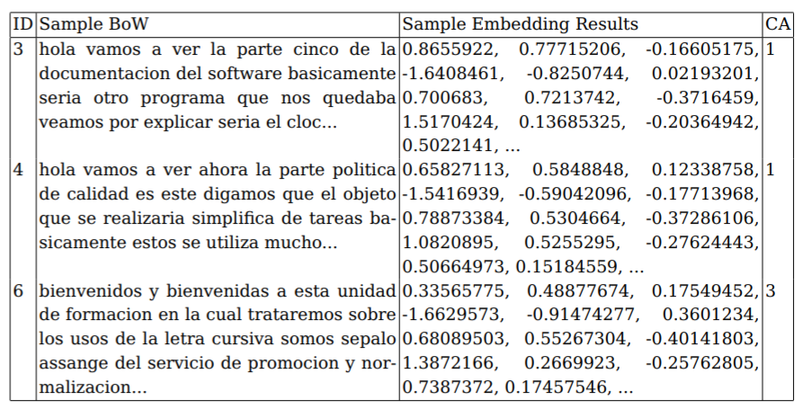
Numerical Results: Word Embedding
For each transcript from the input, the NNLM values are computed and saved in a matrix. The resulted matrix will have 16.012 lines(the number of transcripts) x 128 (the number of dimensions the NNLM algorithm uses)
Sample BoW with NNLM embedding results and cluster assignments:

Slide 15
Numerical Results: LDA Results
Sample LDA models with their topics and scores
ID | LDA: Scores and Topics
3 | Score: 0.844 Topic: 0.005*"filtr" + 0.004*"estad" + 0.002*"clas" + 0.002*"tension" +… Score: 0.083 Topic: 0.002*"dat" + 0.002*"registr" + 0.001*"formulari" + 0.001*"eolic" +… Score: 0.068 Topic: 0.001*"datagr" + 0.001*"estil" + 0.001*"motor“ + + 0.001*"dataset" +… …
4 | Score: 0.699 Topic: 0.005*"filtr" + 0.004*"estad" + 0.002*"clas" + 0.002*"tension" +… Score:0.245 Topic:0.002*"dat" + 0.002*"registr" + 0.001*"formulari" + 0.001*"eolic" +… Score: 0.053 Topic: 0.001*"datagr" + 0.001*"estil" + 0.001*"motor" + 0.001*"dataset" +… …
6 | Score: 0.611 Topic: 0.001*"oracion" + 0.001*"pronombr" + 0.001*"agu" + … Score: 0.227 Topic: 0.001*"plan" + 0.001*"edifici" + 0.001*"sistem" + 0.001*"element" +… Score: 0.049 Topic: 0.001*"plan" + 0.001*"control" + 0.001*"derech" + 0.001*"punt" +… …

Slide 16
Numerical Results: Queries
Query processing results example:
Query | Assigned Cluster | LDA Scores (Topic ID and Score) | Ranked list of transcripts (transcript ID and score)
Ciencias de la Computacion | 2 | (0, 0.4422) (1, 0.0530) (2, 0.0443) (6, 0.0335) (7, 0.4258) ... | (41107,0.1097) (765,0.1120) (18460,0.1124) (3895,0.1141) (1236,0.1146) ...
permanente para la proteccion de los animales en cria instituido | 2 | (6,0.01429) (7,0.871) (8,0.01428) (9,0.01428) ... | (44794,0.0012) (27277,0.0017) (44466,0.032) (26721,0.0428) (41793,0.0428) ...

Slide 17
Validation
Validation is the part of the project that has proved to be the most difficult mostly because we are working with real-life data and therefore, we do not possess the ground truth needed so that we may validate our work with ease. For validation, a couple of approaches have been investigated and tested including:
Applying TextRazor’s state-of-the-art Natural Language Processing and Artificial Intelligence API (Crayston) to parse, analyze and extract semantic meta-data from the transcripts to see if the detected Categories and Topics are related to our query.
Applying the LSTM Siamese Text Similarity (Srivastava) algorithm on the top 3 results from a couple of queries to check if the recommended transcripts for those queries are similar to each other.
Manual validation by looking at the recommended transcripts from a query.

Slide 18
Validation – TextRazor Results
Query | Ranked list of transcripts | TextRazor Output for the first transcripts
 |  | First | Second | Third
La energía nuclear o atómica es la que se libera espontánea o artificialmente en las reacciones nucleares | (26798, 0.0575) (40198, 0.0583) (39614, 0.0589) (30846, 0.0670) (28567, 0.0829) | 0.54 - science and technology 0.45 - environment 0.42 - science and technology>mechanical engineering 0.42 - environment>natural resources>water 0.36 - science and technology>technology and engineering>civil engineering | 0.69 - science and technology>natural science>physics 0.48 - science and technology>natural science>chemistry 0.44 - science and technology>natural science 0.43 - science and technology>mechanical engineering 0.41 - science and technology>natural science>physics>nuclear physics>particle physics 0.41 - science and technology>natural science>physics>nuclear physics | 0.62- science and technology>natural science>chemistry 0.55 - science and technology 0.55 -economy, business and finance>economic sector>chemicals 0.50 - science and technology>natural science>physics 0.45 - science and technology>natural science 0.38 - science and technology>natural science>physics>nuclear physics>particle physics
La ley (en latín, lex, legis) es una norma jurídica dictada por el legislador, es decir: un precepto establecido por la autoridad competente, en que se manda o prohíbe algo en consonancia con la justicia cuyo incumplimiento conlleva a una sanción | (32529, 0.0244) (38848, 0.0248) (1509, 0.0250) (44365, 0.0250) (22254, 0.0306) | 0.64 - politics>government 0.64 -crime, law and justice>law 0.62 -crime, law and justice>law>civil law 0.59 - society>values>ethics 0.57 - politics 0.53 - politics>government>constitution (law) 0.52 - science and technology 0.46 - crime, law and justice>law>civil law>regulation 0.46 - society>values 0.46 - society | 0.70 - crime, law and justice>law 0.68 - politics>government 0.67 - crime, law and justice>law>civil law>regulation 0.64 - politics 0.62 - crime, law and justice>law>civil law 0.53 - politics>government>constitution (law) 0.48 - politics>government>heads of state 0.48 - society>values>ethics 0.46 - society 0.43 - crime, law and justice | 0.59 - economy, business and finance>economy 0.59 - science and technology>social sciences>economics 0.53 - crime, law and justice>law 0.52 - politics 0.46 - economy, business and finance>economic sector 0.45 - science and technology>social sciences 0.45 - politics>government

Slide 19
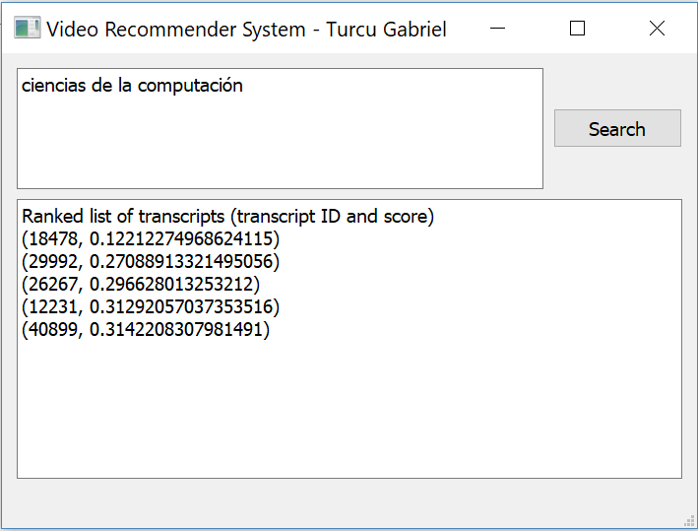
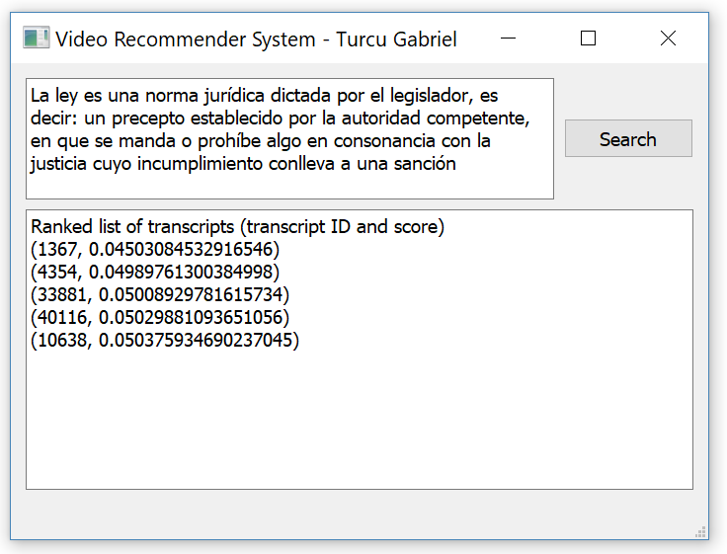
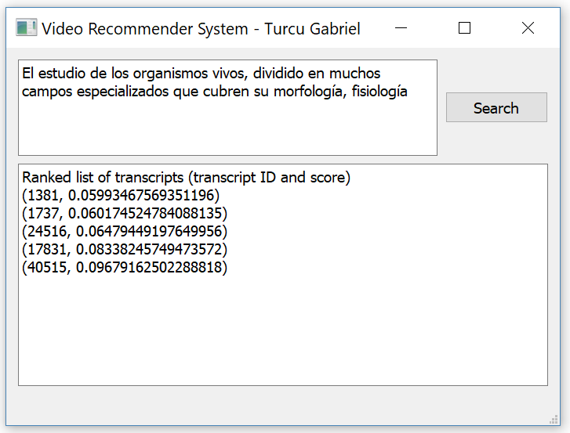
GUI and Application Showcase

Slide 20
Conclusions
In this project, a custom procedure for indexing and retrieving video transcripts has been implemented. The 16.012 input transcripts are from educational videos available from https://media.upv.es/
The data analysis pipeline consists of
tokenizing
computing NNLM embedding results
clustering transcripts and building one LDA model for each cluster.
Once the LDA models are available, the query provided by the user is preprocessed and labelled (i.e., assigned to a cluster) and the corresponding LDA model is used for obtaining the most similar topics (i.e., with highest scores) and therefore the most significant words with their coefficients. These results trace back to the originating transcripts, and consequently, a ranked list of videos is obtained as output.

Slide 21
Acknowledgements
This application was developed during a 2 month Erasmus+ mobility at the Polytechnic University of Valencia.
Beyond the application itself, a scientific paper was created and sent to The International Conference on Hybrid Artificial Intelligent Systems (HAIS: CORE rank C), http://2019.haisconference.eu/. The paper was accepted and will be presented at the conference in September.
The project was presented at the 13th Session of National Scientific Communications (http://stud.inf.ucv.ro/2019/06/sesiunea-nationala-de-comunicari-stiintifice-studentesti-editia-a-13-a/) at the University of Craiova and won third prize.

Slide 22
Questions?

